Slide 1

Voice-Powered Interactive Weather App
PANKAJ KUMAR THAKUR
WEB DEVELOPMENT
August 30, 2025

Slide 2

Introduction to the Voice-Powered Weather App
In today's fast-paced world, access to accurate and timely weather information is crucial. Beyond basic forecasts, there's a growing need for interactive and accessible weather applications that cater to diverse user preferences, including voice-enabled interactions for enhanced convenience.
Importance of Weather Info
Need for Interactive & Voice-Enabled Apps
Weather impacts daily decisions, from what to wear to travel plans. Reliable, up-to-date data is essential for safety and planning.
Traditional apps can be clunky. Voice commands offer hands-free access, while interactive elements make data engaging and easy to digest.
Our Voice-Powered Interactive Weather App addresses these needs by combining real-time data with intuitive voice commands and a dynamic visual experience.

Slide 3
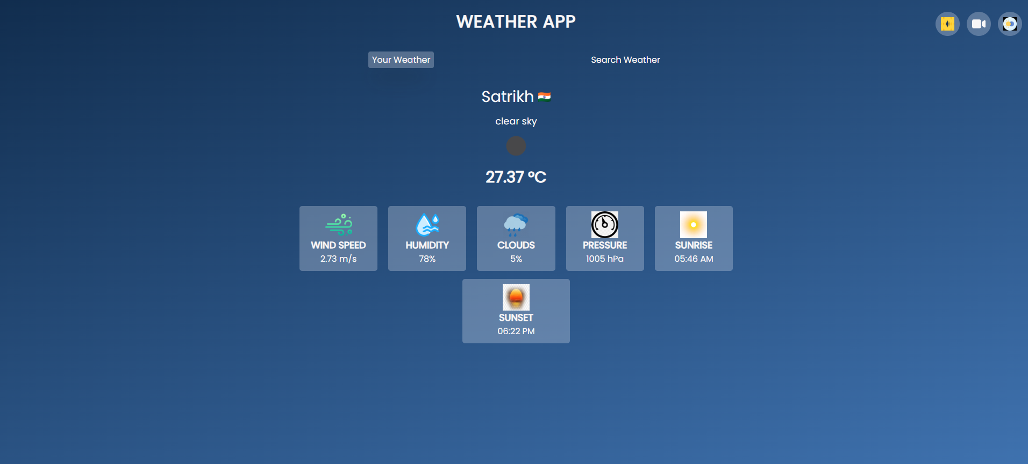

Slide 4





Key Features & Objectives
The Voice-Powered Interactive Weather App is designed to provide a rich and intuitive user experience, integrating both essential weather data and innovative interactive elements. Our primary objectives focus on delivering real-time accuracy, dynamic visual feedback, and seamless voice interaction.
Real-time Weather Data
Instant updates on temperature, conditions, humidity, and wind speed.
Voice Reports
Hear the weather forecast read aloud for hands-free convenience.
Dynamic Backgrounds
Visuals that adapt to current weather conditions (e.g., sunny, rainy).
Sunrise/Sunset Times
Essential astronomical information for daily planning.
7-Day Forecast
Comprehensive outlook for the week ahead, aiding long-term planning.
These core features work together to create a comprehensive and user-friendly weather application, making weather information more accessible and engaging for everyone.

Slide 5
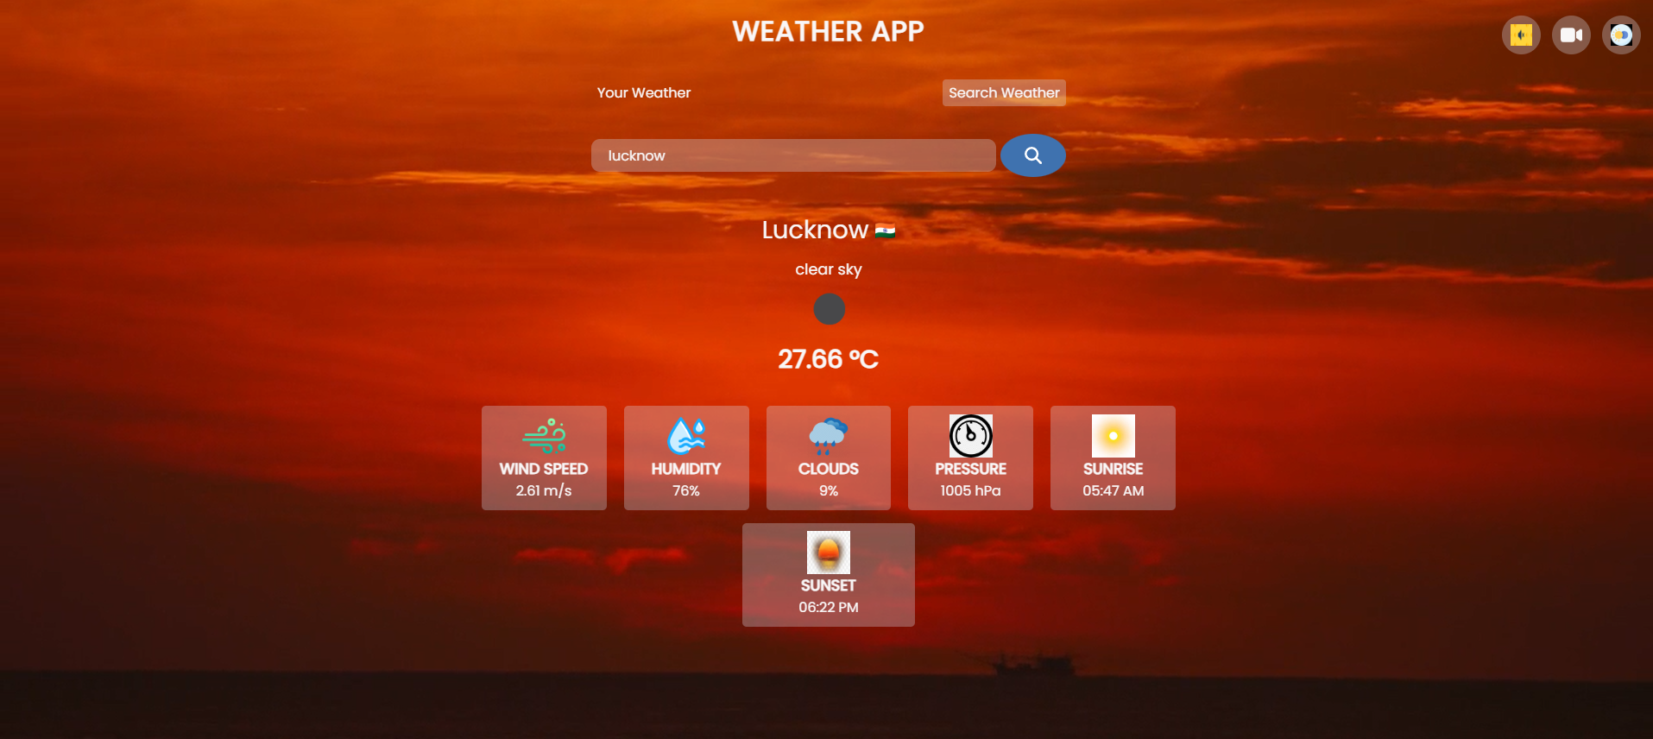

Slide 6



Deployment & Repository Best Practices
Successfully deploying your weather app and presenting it professionally are critical steps after development. This ensures accessibility for users and provides a clear, attractive overview for collaborators or evaluators.
Deployment Options
Repository Essentials
GitHub Pages
Free, simple hosting directly from your GitHub repo. Ideal for static sites. Just push your code, configure settings, and get a live URL.
Repo Description
A concise, engaging summary. E.g., "A responsive, interactive Weather App with voice-powered forecasts..."
Vercel / Netlify
Cloud platforms offering fast, continuous deployment directly from Git. Great for modern web projects with automated builds and global CDNs.
README Structure
Security Note: Always restrict API keys or use a backend proxy to prevent exposure in client-side code.
Crucial for project understanding. Include: Features, Technologies, Demo, Installation, Usage, Screenshots, and Author details.
A well-structured README acts as a user manual and developer guide, showcasing your project's capabilities and ease of use.

Slide 7
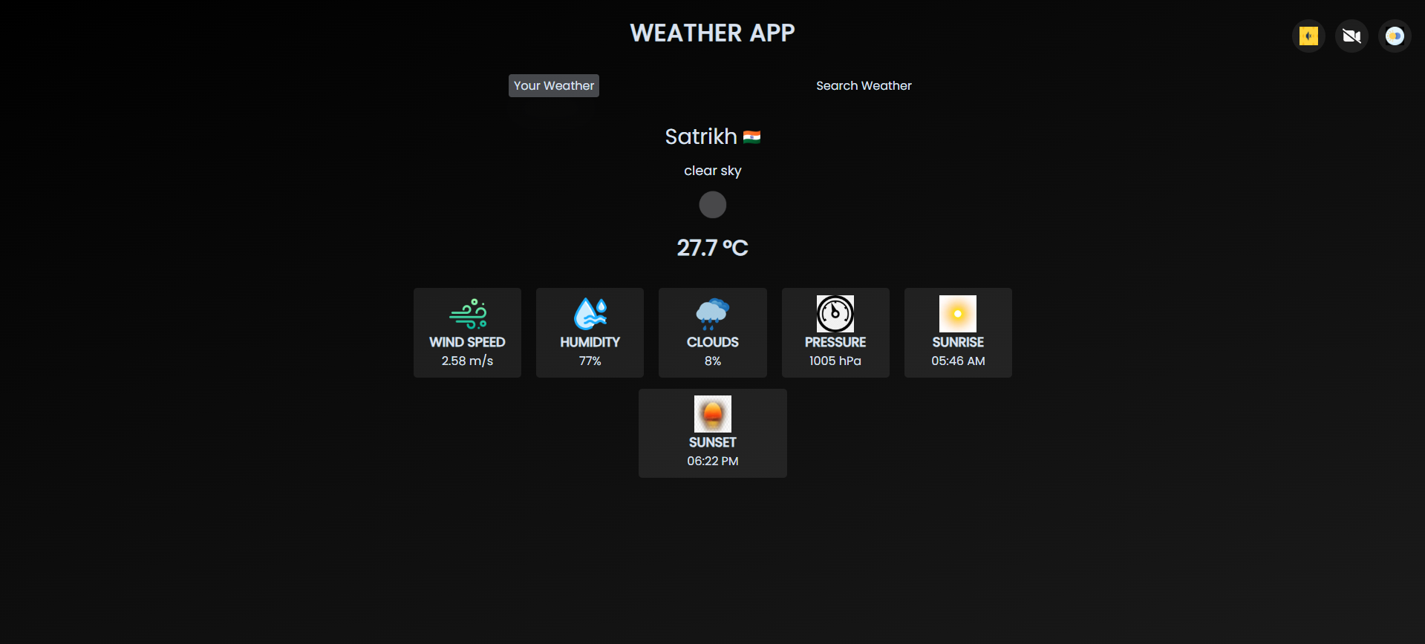

Slide 8






Core Technologies & Installation Guide
Our Voice-Powered Interactive Weather App leverages a robust stack of web technologies to deliver its rich functionality and dynamic user experience. Understanding these components is key to appreciating the app's capabilities and for anyone looking to contribute.
HTML5
CSS3
Provides the foundational structure and semantic markup of the web pages.
Manages the styling, layout, and dynamic background transitions for a visually appealing interface.
JavaScript (ES6+)
OpenWeatherMap API
Powers dynamic content, API integrations, and the voice assistant features.
Fetches real-time weather data for global locations.
Web Speech API
Leaflet.js
Enables voice recognition for commands and text-to-speech for forecasts.
Integrates interactive weather maps with cloud and precipitation overlays.
Installation Guide
To get the app running locally, follow these simple steps:
01
02
03
Clone the Repository
Open in Browser
Add API Key
Navigate to the cloned directory and open index.html in your web browser.
Ensure your OpenWeatherMap API key is replaced in script.js (look for YOUR_API_KEY).
git clone https://github.com/your-username/Voice-Powered-WeatherApp.git

Slide 9
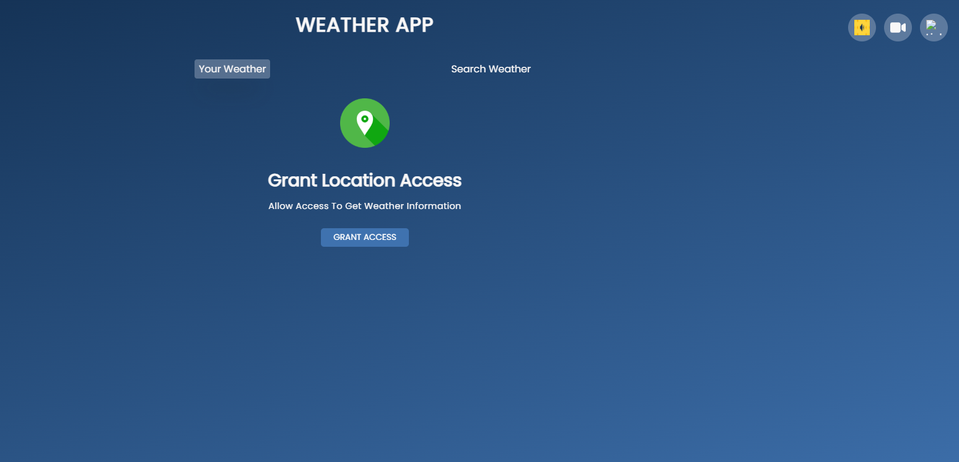

Slide 10


App Overview & Live Demo
The Voice-Powered Interactive Weather App is a responsive, intuitive web application offering real-time weather forecasts. It integrates dynamic visual elements with voice-activated commands for a seamless user experience, providing critical data like current conditions, sunrise/sunset times, and a comprehensive 7-day outlook, powered by the OpenWeatherMap API.

Slide 11
